Slide 1

Project Title – Healthcare Analytics for Doctor Visits_TIRTC
Vaibhavi Shukla
STU690cb34e4f5eb1762440014

Slide 2

PROBLEM STATEMENT
Healthcare utilization can vary considerably among individuals because of differences in age, socioeconomic conditions, illness, health status, insurance coverage, and chronic health conditions.
The problem addressed by this project is to analyze the factors associated with the frequency of doctor visits and identify meaningful patterns in healthcare utilization.
By studying the available patient information, the project aims to understand whether factors such as illness, reduced activity, poor health, chronic conditions, income, and healthcare coverage are associated with a higher or lower number of doctor visits.

Slide 3
Project Description-
Healthcare analytics aims to understand the factors that influence patients' visits to doctors and healthcare facilities. The objective of this project is to analyze patient demographic, economic, health, and chronic-condition data to identify the key factors associated with the frequency of doctor visits.
The dataset contains information such as gender, age, income, illness, reduced activity, general health status, private insurance coverage, free healthcare eligibility, and chronic illnesses. By analyzing these variables, the project seeks to understand patterns in healthcare utilization and determine which patient characteristics are associated with higher or lower numbers of doctor visits.
The analysis can help identify healthcare utilization patterns, high-risk groups, and socioeconomic or health-related factors affecting access to and use of medical services. These insights can potentially support better healthcare planning, resource allocation, and patient-care strategies.

Slide 4

WHO ARE THE END USERS?
The end users of the Healthcare Analytics for Doctor Visits project can include:
Healthcare Providers – Doctors, clinics, and hospitals can use the analysis to understand patterns in patient visits and healthcare utilization.
Hospital and Healthcare Administrators – They can use the insights for planning resources such as doctors, staff, facilities, and services.
Healthcare Policy Makers – Government health departments and policymakers can use aggregated insights to understand healthcare-access patterns and support planning.
Health Insurance Organizations – Insurance providers can analyze healthcare utilization patterns and understand relationships between insurance coverage and doctor visits.
Healthcare Researchers – Researchers can use the dataset to study relationships between illness, chronic conditions, socioeconomic factors, and healthcare utilization.
Data Analysts and Data Scientists – They can use the dataset to practice exploratory data analysis, visualization, statistical analysis, and predictive modeling.
Healthcare Management Students/Researchers – The project can serve as an educational example of applying data analytics techniques to real-world healthcare data.

Slide 5

Technology Used
  PYTHON
  SEABORN
  MATPLOT LIB
  PANDAS
  NUMPY

Slide 6

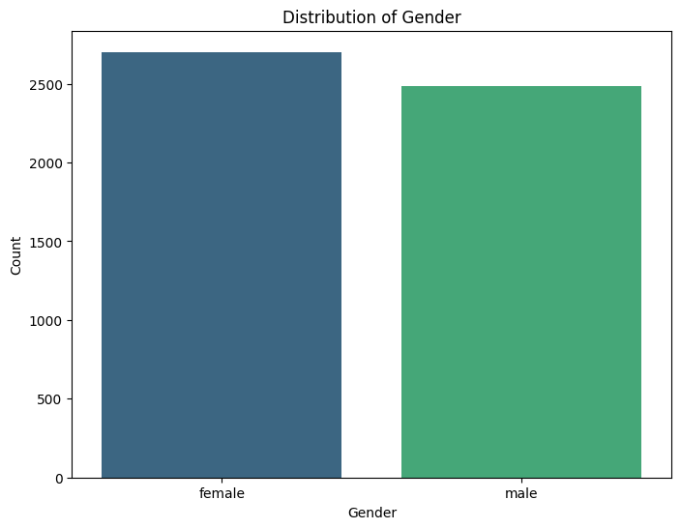

RESULTS

Slide 7
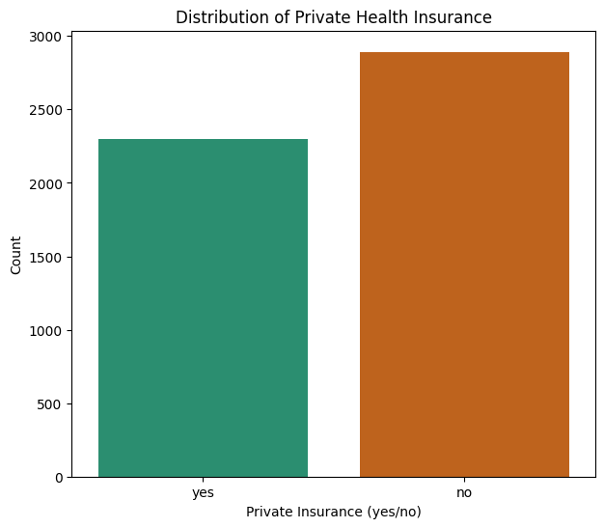
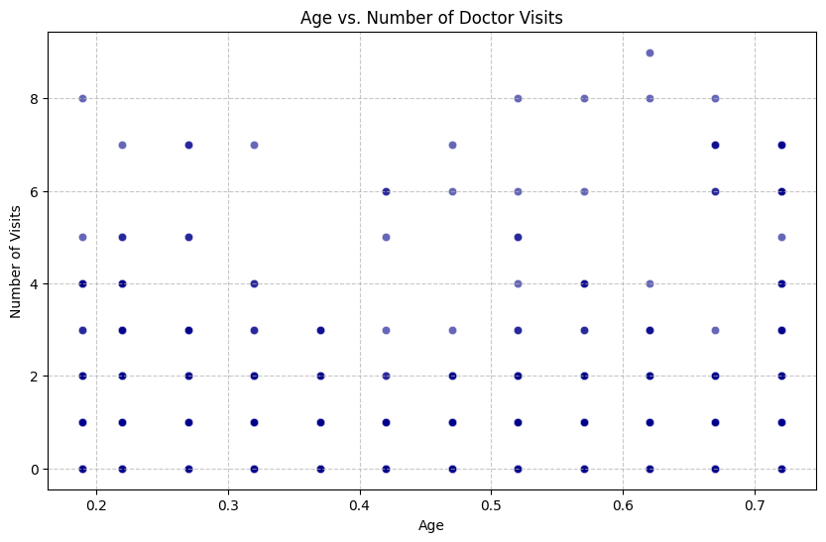
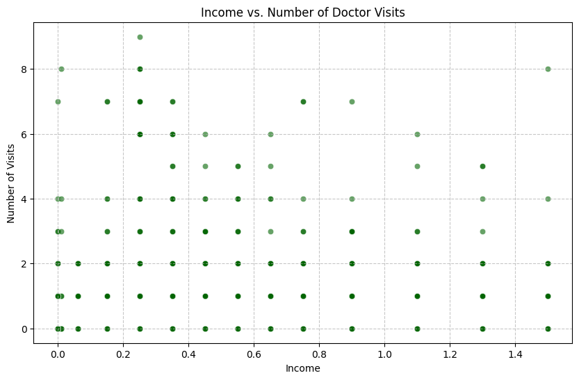
RESULTS

Slide 8
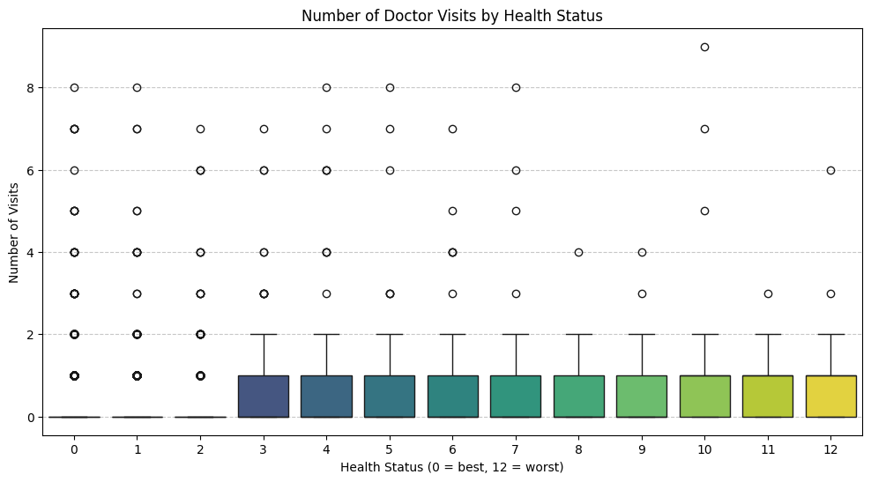
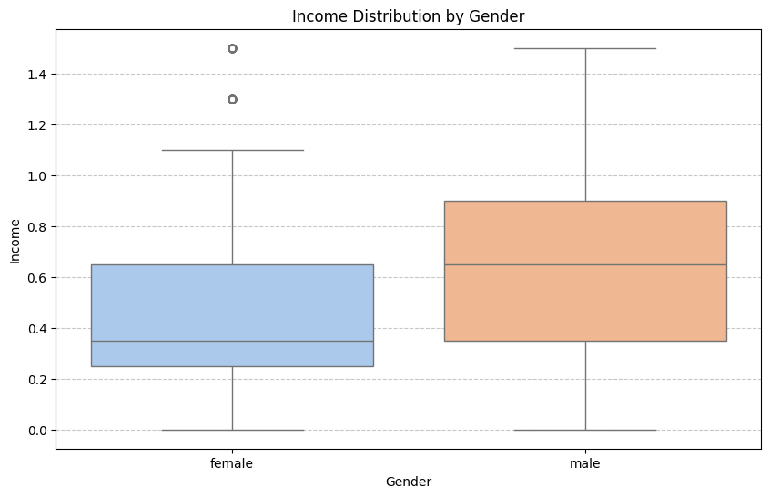
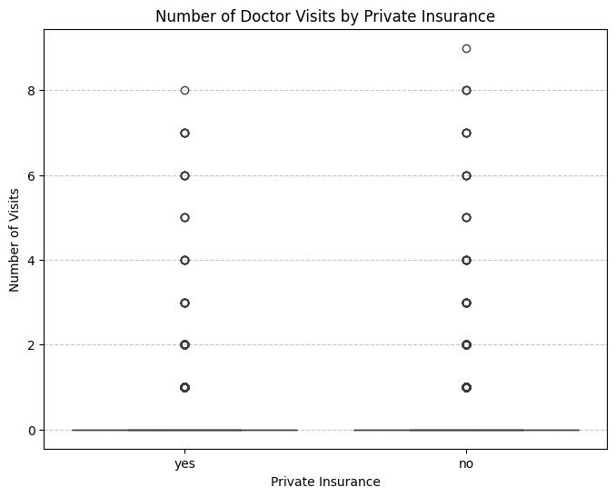
RESULTS
Demo Link- https://github.com/vaibhavishukla45-code/Healthcare-Analytics-for-Doctor-Visits.git

Slide 9
Thank you
.
.

